Slide 1
Icinga2 installation and troubleshooting steps KT

Slide 2

Agenda
Icinga2 cluster overview
Icinaga2 Puppet tags usage step
Getting out of Icinga2 hell
a. SSL cert issue
b. Cluster member disconnected.
c. “/var/log/icinga/api/log” Dir filling fast issue.

Slide 3
Icinga2 cluster overview
restool-cmcd-04c
restools-ch2d-04c
DB MySQL
DB MySQL
Icingaweb2
Cmcd-03c
Ch2d-03c
Icingaweb2
Agile Zone
Black Zone
Ch2d-01c
Cmcd-01c
resplr-po-05.sys.comcast.net
resplr-ch2-05.sys.comcast.net
Ch2d-02c
Cmcd-02c
Ch2d-04c
Cmcd-04c
resplr-po-06.sys.comcast.net
resplr-ch2-06.sys.comcast.net

Slide 4
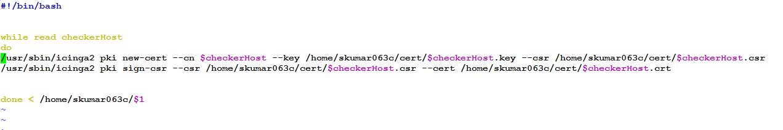
Icinaga2 Puppet tags usage step
bash -x icinga_cert.sh poller.txt
puppet agent --test --noop --tags icinga2

Slide 5
Getting out of Icinga2 hell

Slide 6
a. SSL cert issue
openssl s_client -CAfile /etc/icinga2/pki/ca.crt -cert /etc/icinga2/pki/respoller-cmcd-01c.crt -key /etc/icinga2/pki/respoller-cmcd-01c.key -connect respoller-ch2d-03c:5665
openssl verify -verbose -CAfile /etc/icinga2/pki/ca.crt /etc/icinga2/pki/respoller-cmcd-01c.crt

Slide 7

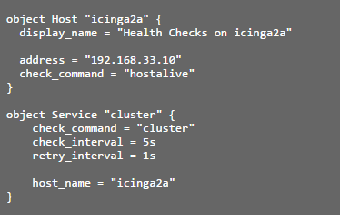
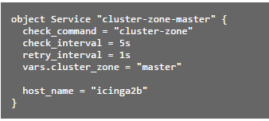
. Cluster member disconnected.
Split-Brain-mode
preventive check alert:

Slide 8
c. “/var/log/icinga/api/log” Dir filling fast issue.
Check the following:
All clients are connected? (e.g. cluster health check).
Check your connection in general.
Does the log replay work, e.g. are all events processed and the directory gets cleared up over time?
Decrease the log_duration attribute value for that specific endpoint.

Slide 9
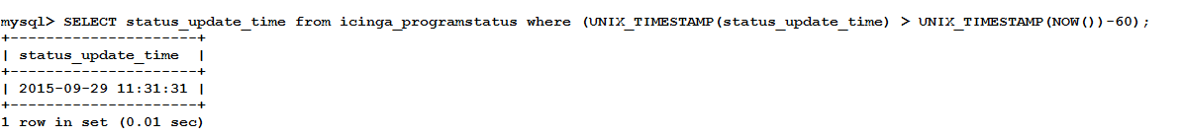
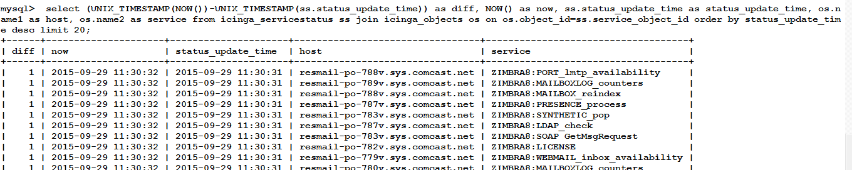
Really helpful MySQL query:

Slide 10
